Slide 1


ScanPath-DFT Insertion & ATPG Coverage Project
End-to-End Implementation of Scan Architecture, Automatic Test Pattern Generation, Rule Verification, and Fault Coverage Optimization

Slide 2


Project Overview & Objectives
Project Overview
Key Objectives
Modern VLSI chips contain millions of gates, making functional post-fabrication testing virtually impossible. This project transforms sequential netlists into structured scan architectures to enable full internal controllability and observability.
High Fault Coverage: Achieve >98% Stuck-At and >92% Transition Delay fault coverage across all testable clock domains.
Pattern & Overhead Optimization: Minimize total test pattern count to reduce ATE test cost while maintaining <2% silicon area overhead.
By replacing standard flip-flops with multiplexed Scan Flip-Flops and stitching them into scan chains, automated test equipment (ATE) can detect structural manufacturing defects.
DRC Clean Design: Guarantee zero DFT violations for asynchronous clock/reset lines and tri-state internal buses.

Slide 3
Prerequisites & Deliverables
Category | Input / Artifact | Technical Purpose | Project Deliverable
Netlist & Constraints | Gate-level Netlist (.v) & SDC | Synthesized gate netlist & target timing constraints | Scan-inserted verilog netlist
Library Models | Liberty (.lib) & DFT DB | Standard cell timing, functional & scan FF models | Updated SDC with test mode constraints
Test Protocol | STIL / WGL Test Vectors | ATE execution procedures and signal timing setup | ATPG pattern suite (STIL & IEEE 1450)
Verification | Zero-Delay Simulation TB | Validate generated patterns against gate-level netlist | ScanDEF file & Coverage summary reports

Slide 4

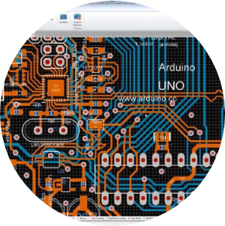
Scan Architecture & Cells
Multiplexed Scan Flip-Flop
The standard D-flip-flop is upgraded to a Scan Flip-Flop by integrating a 2:1 multiplexer at the data input, controlled by the Scan Enable (SE) signal.
During Functional Mode (SE = 0), the flip-flop latches system data (D). During Shift Mode (SE = 1), test vectors are shifted in via Scan In (SI) and shifted out via Scan Out (SO).
This simple silicon change converts hard-to-test sequential logic into easily testable combinational logic during ATE testing.

Slide 5






Phase 1: Testability Prep
RTL & Netlist Audit
DFT Rule Check (DRC)
Clock & Reset Override
Analyze design hierarchy, identify non-scan elements (memories, latches, IP blocks), and define scan register inclusion/exclusion lists.
Run pre-scan DRCs to detect uncontrollable clocks, asynchronous resets, combinational feedback loops, and floating internal nodes.
Insert test control logic (test clocks & reset override muxes) to ensure external ATE control over all storage flip-flops during shift mode.

Slide 6

Phase 2: Scan Insertion
Scan Stitching & Compression
During Phase 2, standard flip-flops are mapped to scan cells and stitched into balanced scan chains based on clock domain and physical layout proximity.
Lockup latches are automatically inserted between cross-clock domain boundaries to eliminate setup/hold skew issues during high-speed shift operations.
Embedded deterministic test (EDT) compression is integrated to maximize scan chain count while utilizing minimal top-level test pins.

Slide 7
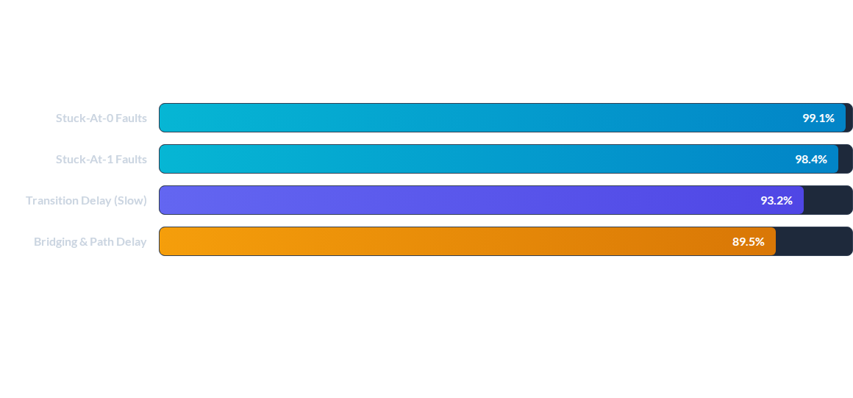
Phase 3: ATPG & Simulation
ATPG pattern generation targeted structural Stuck-At and At-Speed Transition Delay fault models. Dynamic pattern compression significantly reduced test time.

Slide 8
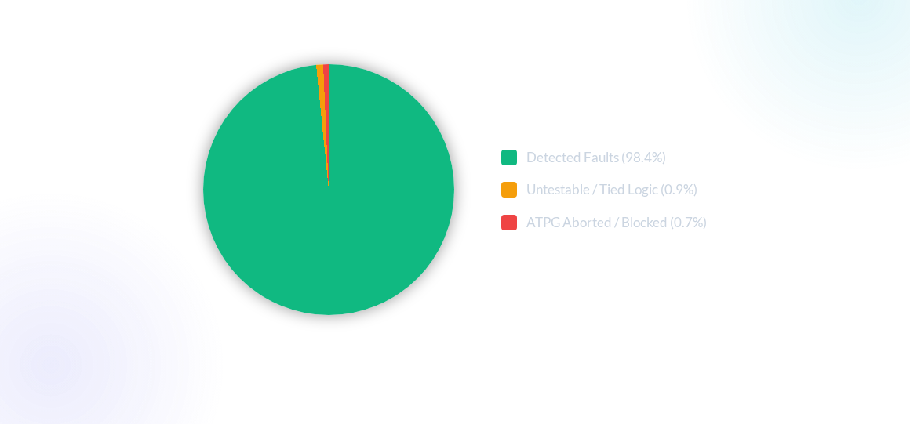
Phase 4: Coverage Reporting

Slide 9




DFT Execution Roadmap
Step 2: Insertion
Step 4: Sign-off
Scan cell replacement, chain stitching & lockup latch placement.
STIL export, zero-delay timing simulation & layout handoff.
Step 1: Prep
Step 3: ATPG
Netlist audit, test control clock/reset insertion & pre-scan DRC clean.
Vector generation for Stuck-at/At-Speed & fault simulation verification.

Slide 10
Coverage Optimization
Test Point Insertion (TPI): Added control and observe test points in deep combinational cones to unlock previously untestable shadow logic.
Asynchronous Reset Gating: Enforced dedicated test-mode overrides on RAM/IP reset lines to prevent random register resets during shift sequence.
Tri-State & Bus Contention Control: Disabled internal bus drivers during test shift mode to prevent high-current physical contention damage.
Power-Aware Scan Shift: Configured scan chain interleaving to prevent IR-drop violations caused by high switching activity during ATPG pattern shift.

Slide 11

Key Performance Metrics
Silicon Impact Analysis
98.4%
384 Stitched Scan Chains: Perfectly balanced chain lengths across 3 main functional clock domains.
1.64% Area Overhead: Minimal silicon die penalty added by multiplexed scan flip-flops and test logic.
Stuck-At Fault Coverage
65% Vector Reduction: EDT compression compressed test pattern volume, substantially lowering ATE test time costs.

